Slide 1

Data Structures: Project Presentation
< Title: BUS RESERVATION SYSTEM >
< Title: LIBRARY MANAGEMENT SYSTEM>
Team Details Date: < 6/2/24 >
Vedasri : 22WH1A05D5
Chermista : 22WH1A05J3
Ruth Mercy: 23WH5A0519
Joshitha: 22WH1A05G4
Ameena : 23WH5A0516
Faculty: Ms.B.Nagaveni
Designation: Assistant Professor
Department of Computer Science & Engineering

Slide 2
PROJECT INTRODUCTION
Technology
Data Structures Using C programming
Proposed system
The Bus Reservation system facilitates the passengers to enquire
about the bus availability and reserve his/her seat before travelling. This
system allows to reserve the tickets for multiple people from one part
of the country to another part of the country. This project contains
introduction to the bus reservation system ,it includes reserve a seat, cancel reservation, checking availability of seats
Concepts Used
Arrays
Linear Search
Functions
Switch statements

Slide 3
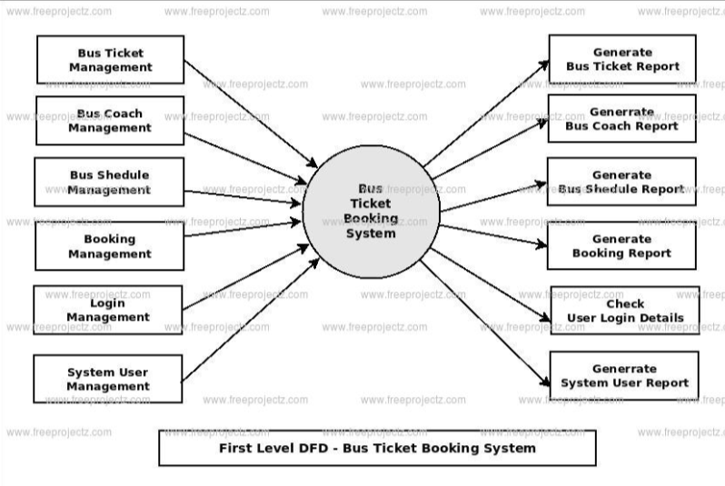
Architecture

Slide 4
Functions & Workflow
Initialization of Structures and Variables
2. Main Function and Program Loop
3. Main Menu (displayMainMenu)
4. User Login (loginUser)
5. User Menu (displayUserMenu)
6. Booking a Ticket (bookTicket)
7. Canceling a Ticket (cancelTicket)
8. Checking Bus Status (checkBusStatus)
9. Logging Out
10. Exiting the Program

Slide 5
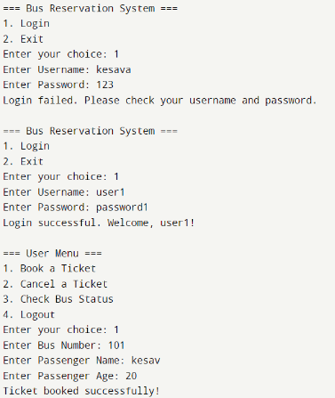
Output

Slide 6
Thank You

